Slide 1
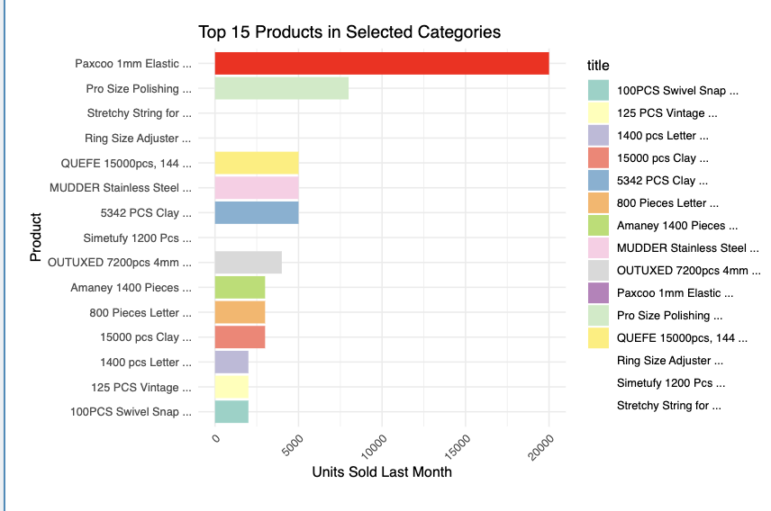
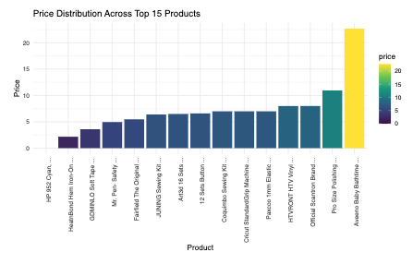
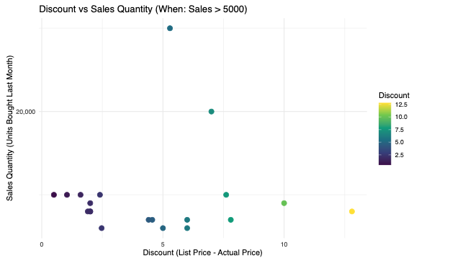
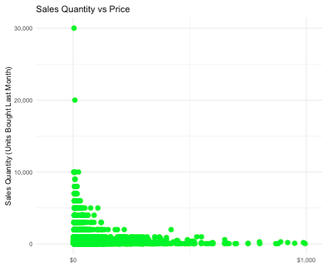
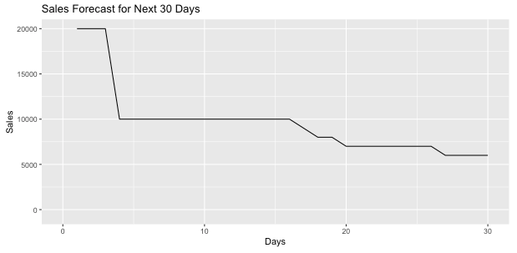
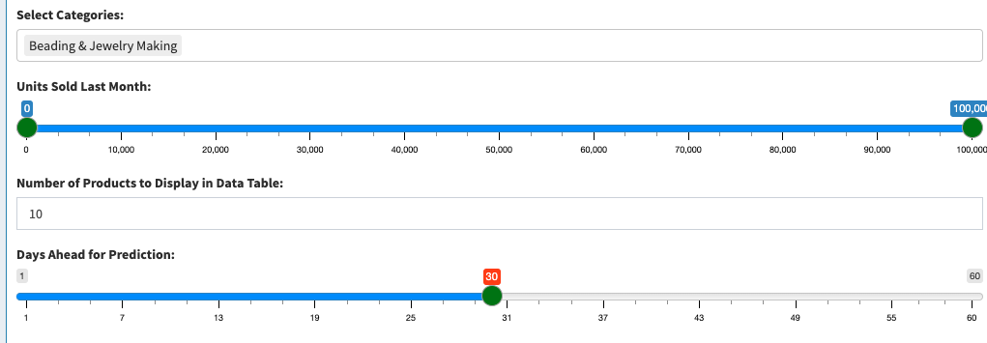
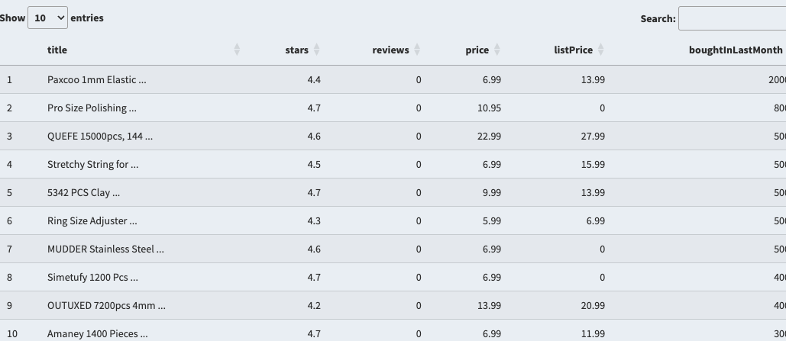
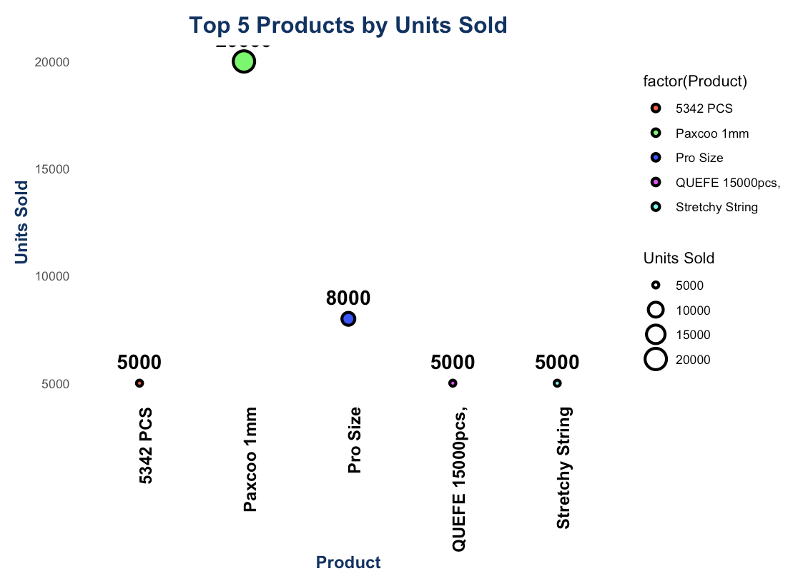
Amazon Seller Dashboard
GEOM90007 Information Visualization
DESIGN SUMMARY
Saad Sheikh(1384242) saadullahs@student.unimelb.edu.au
1
KPI BOX
Quick glance at sellers KPI
Sale Distribution
Find Top 15 Sellers
Price Distribution
Find best price to Sell
Scatter Plot
How Discounts impacts Sales
Scatter Plot
How Price Impact Sales
Forecast
Predicted Sale for any item
SELECTION PANEL
EXPORT PANEL
Scaling
Scatter Plot
How Discounts impacts Sales

Slide 2

DATA SOURCES
Kaggle Datasets
Provides the sales data across 1.4M Amazon product sales in 2023
https://www.kaggle.com/datasets/asaniczka/amazon-products-dataset-2023-1-4m-products
2
ADDITIONAL NOTES
The dashboard design has been inspired by multiple online Repos as follows:
https://www.oreilly.com/library/view/r-for-everyone/9780134546988/ch29.html#ch29lev1sec1
https://www.actuartech.com/insights
https://github.com/advait22/GEOM90007
https://github.com/GEOM90007-2022-S2/POIs-in-Melbourne
Note:
*For interactive dashboard I applied interactivity on selection level (select items ,days etc)
*For Sales/Distribution you can dynamically click and find details about item
*Applied exponential smoothing estimation to improve sales using prediction

